Slide 1


Monitoring and Logging in Kubernetes

Slide 2



Course : Mastering DevOps
Lecture On : Monitoring and Logging in Kubernetes
Instructor: Dipesh Garg

Slide 3
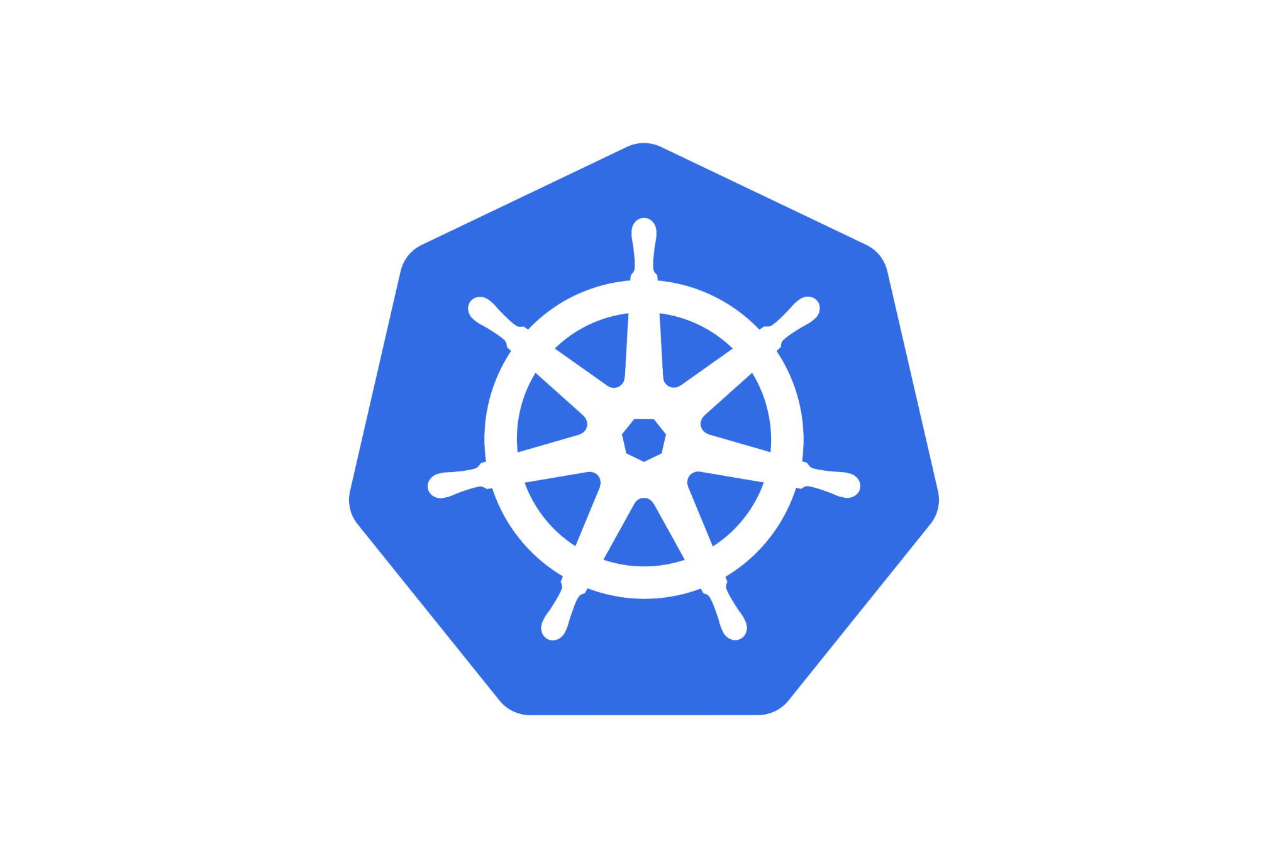
Kubernetes Objects
Orchestration Using Kubernetes

Slide 4
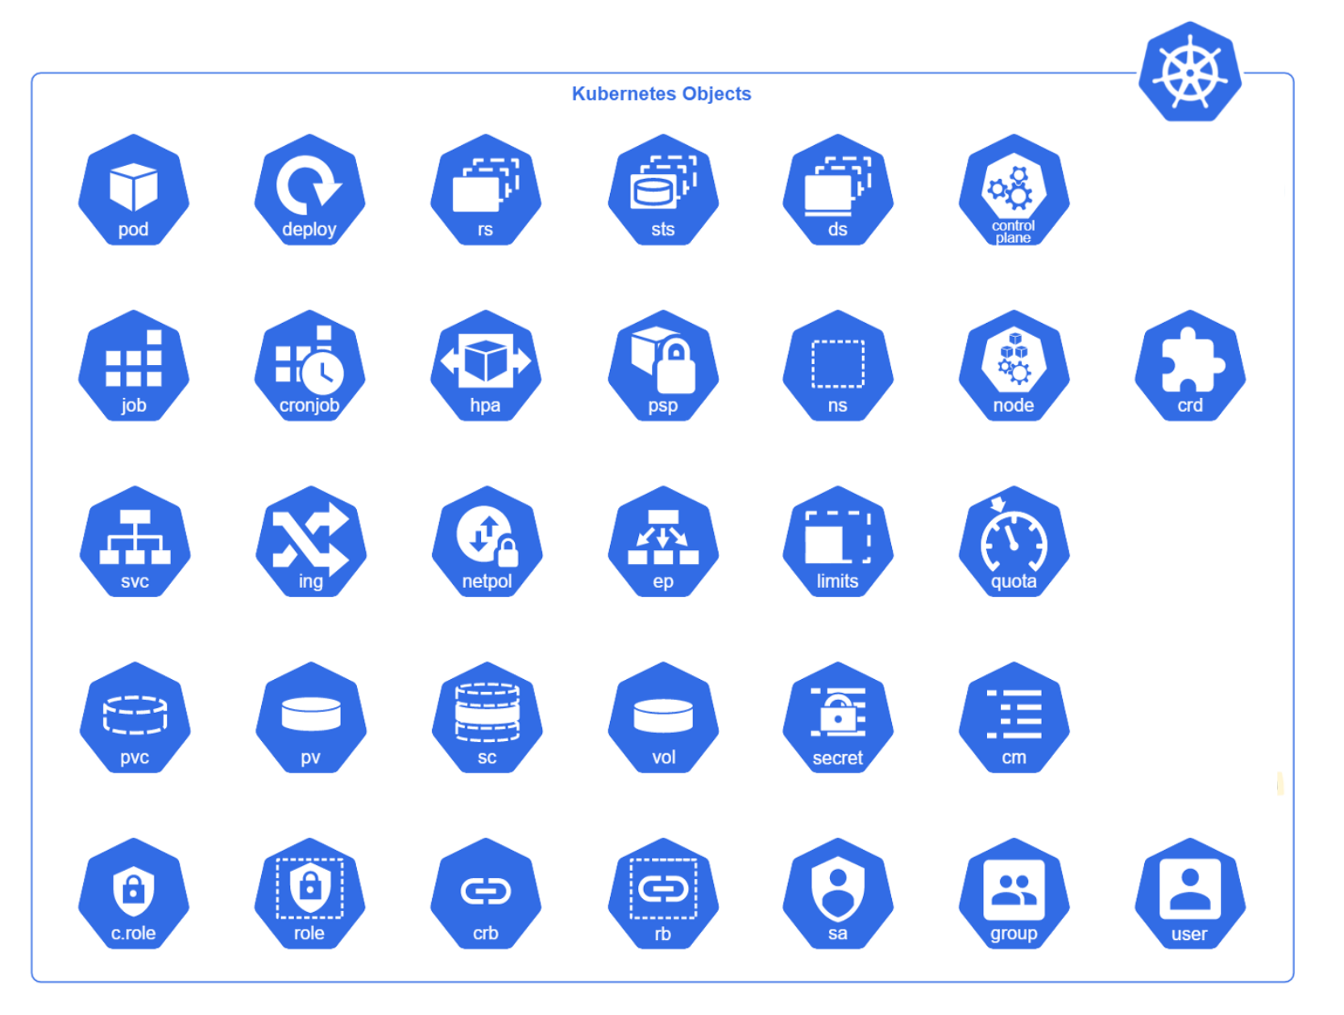
KUBERNETES OBJECTS

Slide 5
KUBERNETES OBJECTS
Kubernetes objects are persistent entities in the cluster. These objects are used to represent the state of the cluster.
To work with Kubernetes objects – to create, modify, or delete them – you will need to use the Kubernetes API.
Some of the important Kubernetes objects are:
  Pods
  ReplicaSets
  Deployment
  Namespaces
  Services
  ConfigMaps
  StatefulSets
  DaemonSets

Slide 6
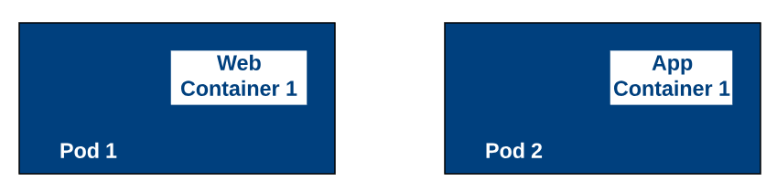
PODS

Slide 7
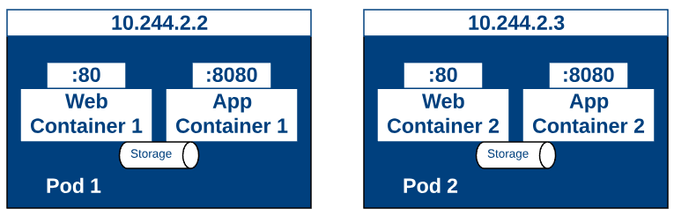
PODS

Slide 8
PODS
The smallest and standardised deployable units of computing that can be created and managed in Kubernetes.
Represents a single instance of a process running in your cluster.
Pods contain one or more containers, such as Docker containers. When a pod runs multiple containers, the containers are managed as a single entity and share the pod's resources.
Pods also contain shared networking and storage resources for their containers:
  Network
  Storage

Slide 9
YAML FILE IN KUBERNETES
Kubernetes uses YAML files as inputs to create objects such as pods, replica sets deployments and services. All of these follow a similar structure.
Kubernetes’ definition file always contains four top-level fields.
  The API version, kind, metadata and spec.
  These are the root level or top-level properties.
  These are also required fields, so you must have them in your configuration file.
kubectl create -f <file-name>.yaml
kubectl apply -f <file-name>.yaml

Slide 10
STRUCTURE OF A YAML FILE
apiVersion:
kind:
metadata:
spec:

Slide 11
YAML IN KUBERNETES
apiVersion: v1
kind: Pod
metadata:
name: my-nginx
labels:
tier: frontend
spec:

Slide 12
YAML IN KUBERNETES
apiVersion: v1
kind: Pod
metadata:
name: my-nginx
labels:
tier: frontend
spec:
containers:
- name: web-app
image: nginx

Slide 13
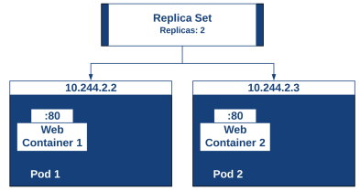
REPLICASETS

Slide 14
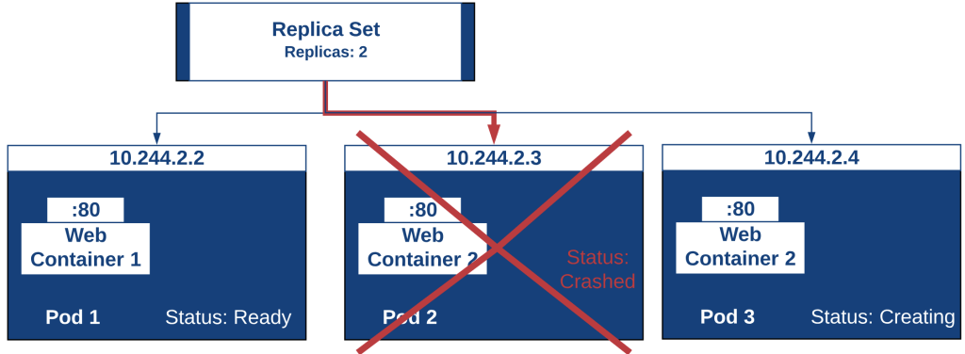
REPLICASETS

Slide 15
REPLICASETS
The purpose of a ReplicaSet is to maintain a stable set of replica pods running at any given time.
They are often used to guarantee the availability of a specific number of identical pods.
A ReplicaSet is defined with fields, including the following:
  A selector that specifies how to identify pods it can acquire
  A number of replicas indicating how many pods it should be maintaining
  A pod template specifying the data of new pods should create to meet the number of replicas criteria

Slide 16
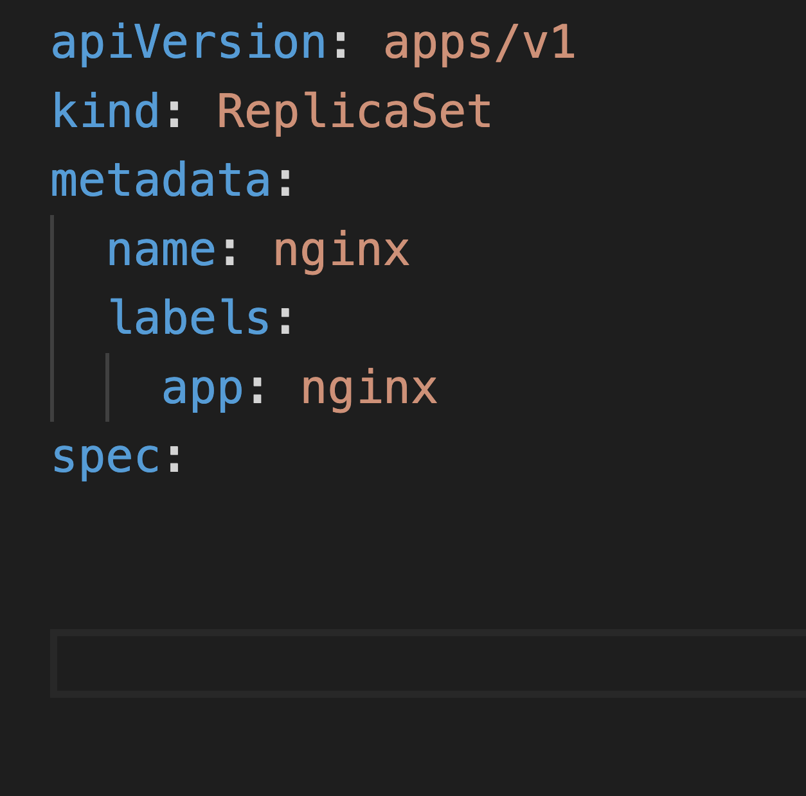
REPLICASETS

Slide 17
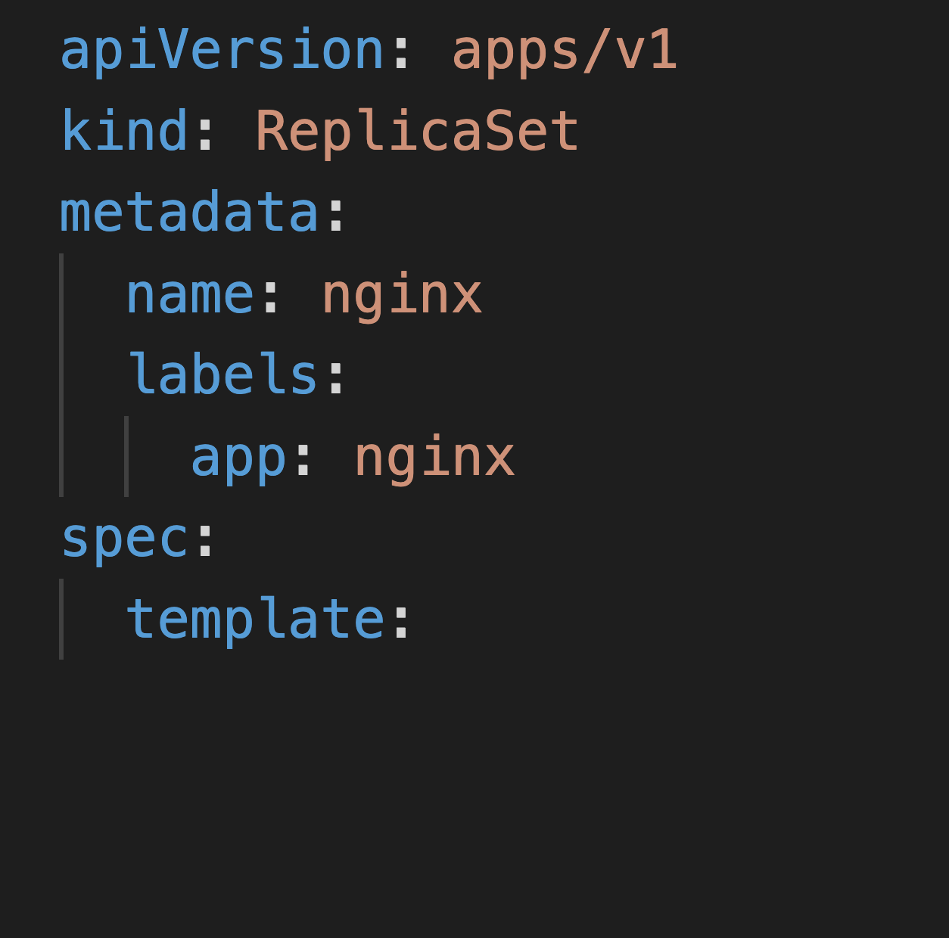
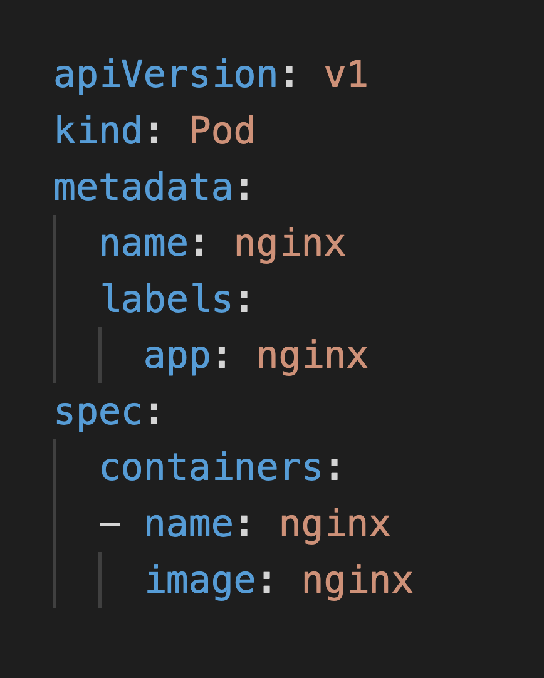
REPLICASETS

Slide 18
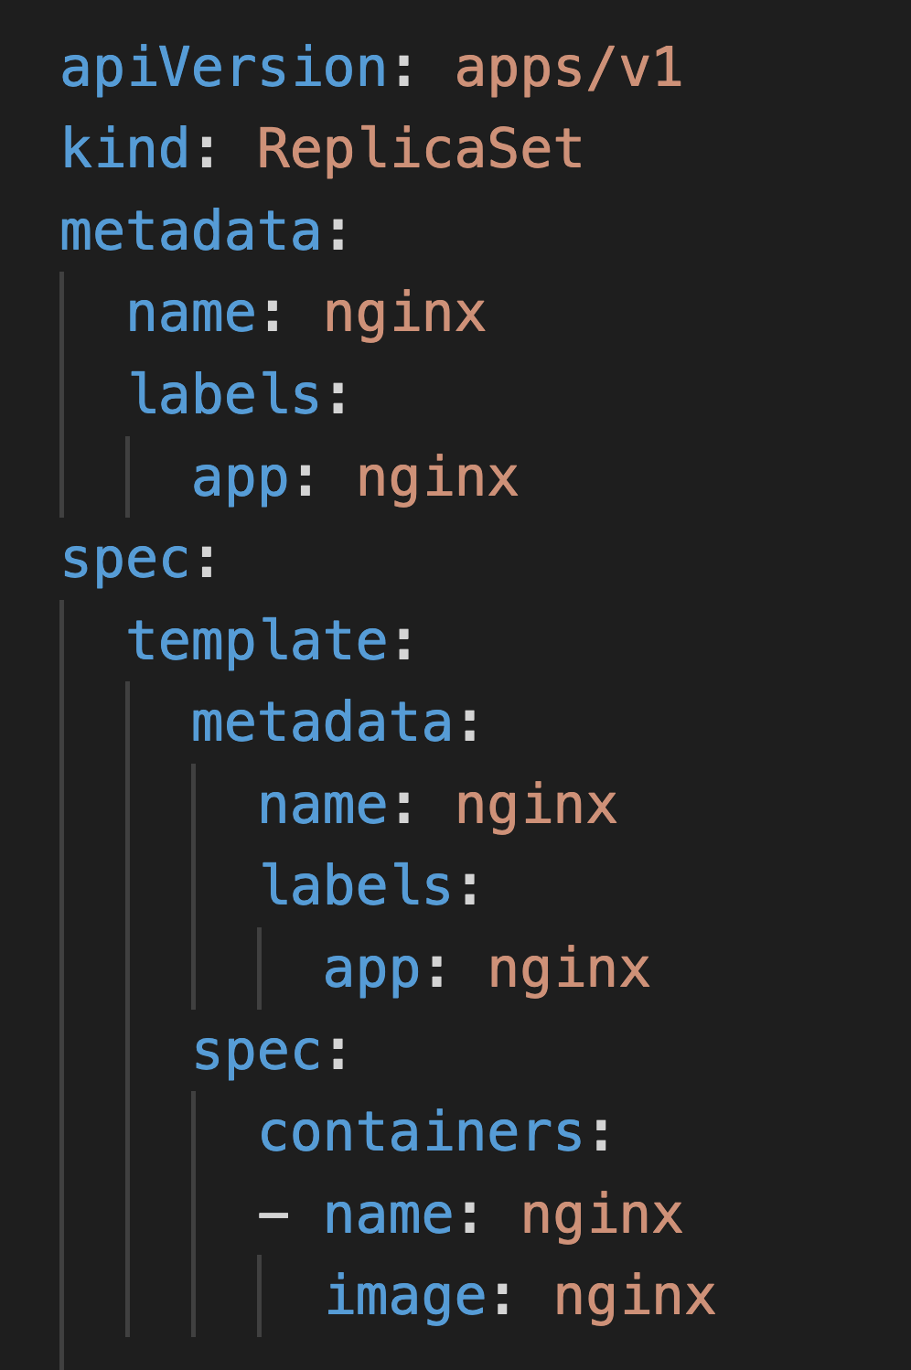
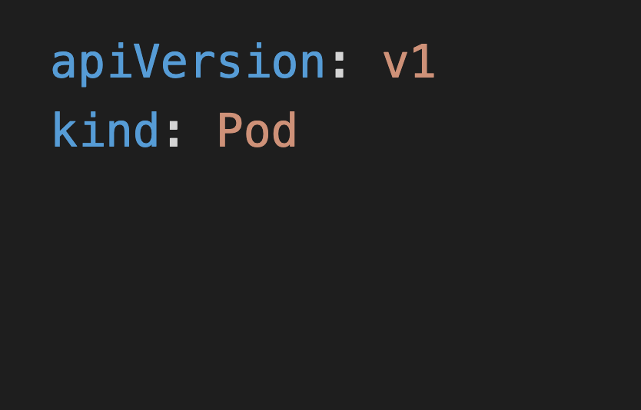
REPLICASETS

Slide 19
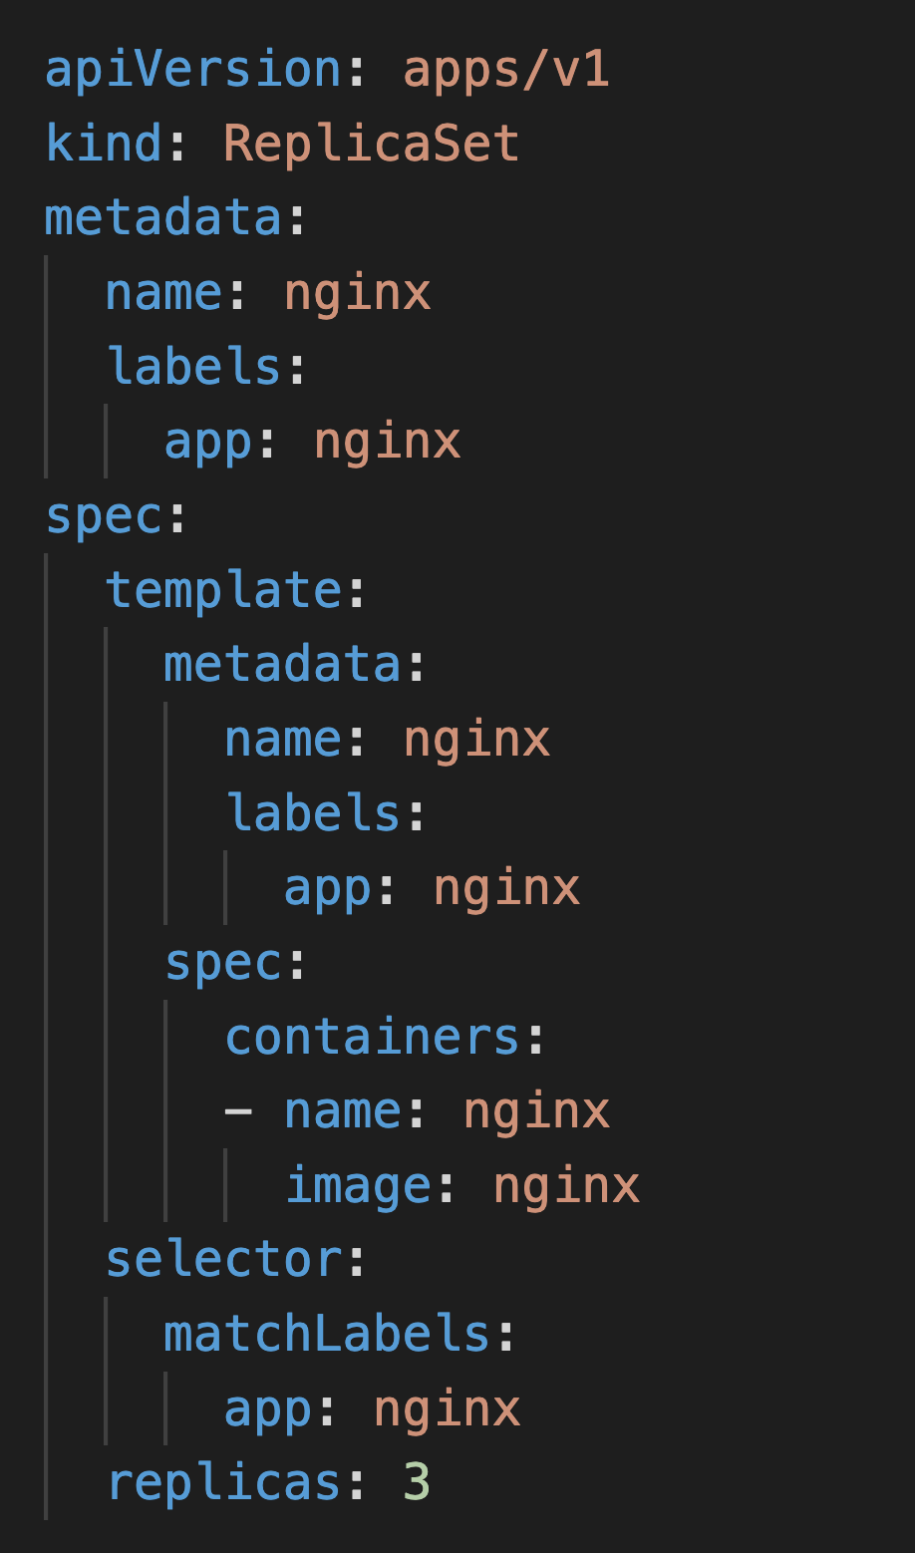
REPLICASETS

Slide 20
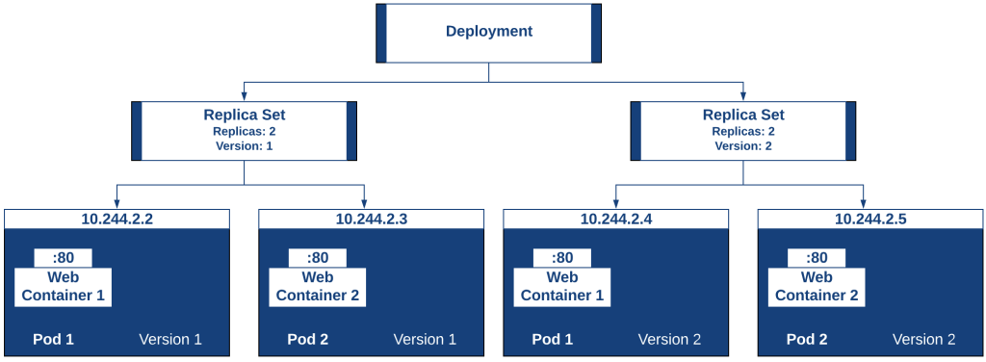
DEPLOYMENTS

Slide 21
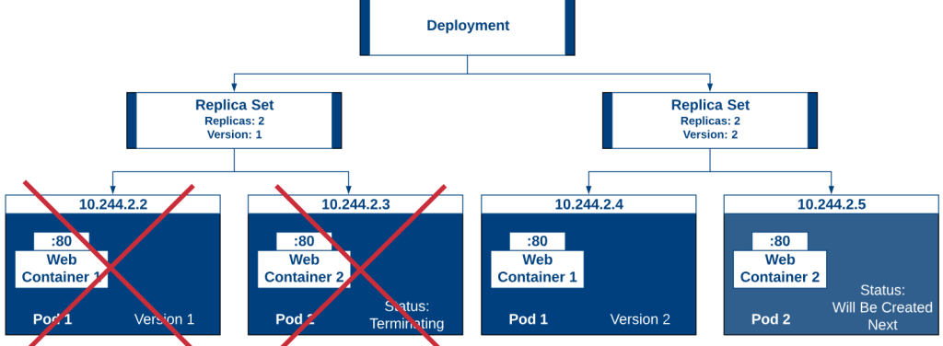
DEPLOYMENTS

Slide 22
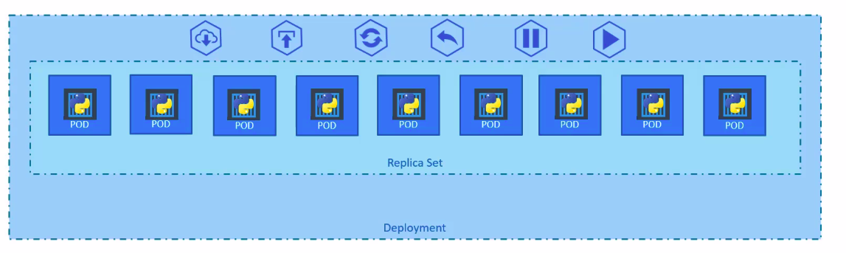
DEPLOYMENTS
The deployment provides declarative updates for pods and replicasets.
We describe a desirable state in the deployment, and the deployment controller changes to the desired state from the actual state at a controlled rate.

Slide 23
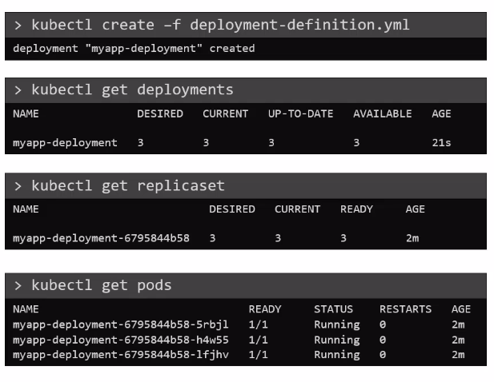
YAML FILE FOR DEPLOYMENTS
apiVersion: apps/v1
kind: Deployment
metadata:
name: nginx-deployment
labels:
app: nginx
tier: front-end
spec:
template:
metadata:
name: nginx-pod
labels:
app: nginx
spec:
containers:
name: nginx
image: nginx
selector:
matchLabels:
app: nginx
replicas: 3

Slide 24
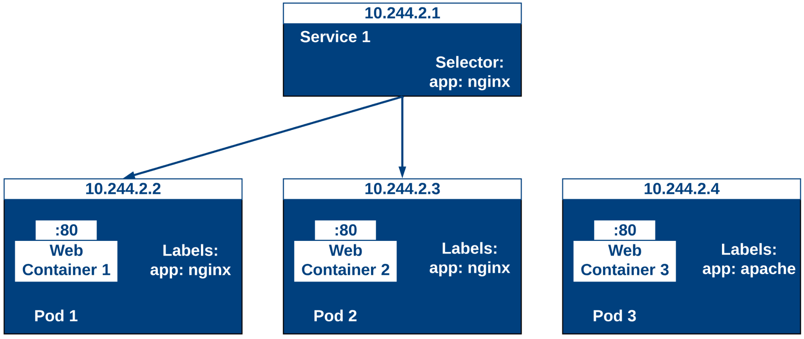
YAML FILE FOR DEPLOYMENTS

Slide 25
YAML FILE FOR DEPLOYMENTS
Pods are non-permanent resources. If you use a deployment to run your app, it can create and destroy pods dynamically.
It defines:
  Logical set of pods
  Policy to access them
A selector usually determines the set of Pods targeted by a service.
Kubernetes service types allow you to specify what kind of service you want. The default is ClusterIP.

Slide 26
SERVICE TYPES
ClusterIP: It exposes the service on a cluster-internal IP. Choosing this value makes the service reachable only from within the cluster. This is the default ServiceType.
NodePort: It exposes the service on each node's IP at a static port. NodePort service can be contacted from outside the cluster by requesting <NodeIP>:<NodePort>.
LoadBalancer: It exposes the service externally using a cloud provider's load balancer.
ExternalName: It maps the service to the contents of the externalName field by returning a CNAME record with its value.

Slide 27
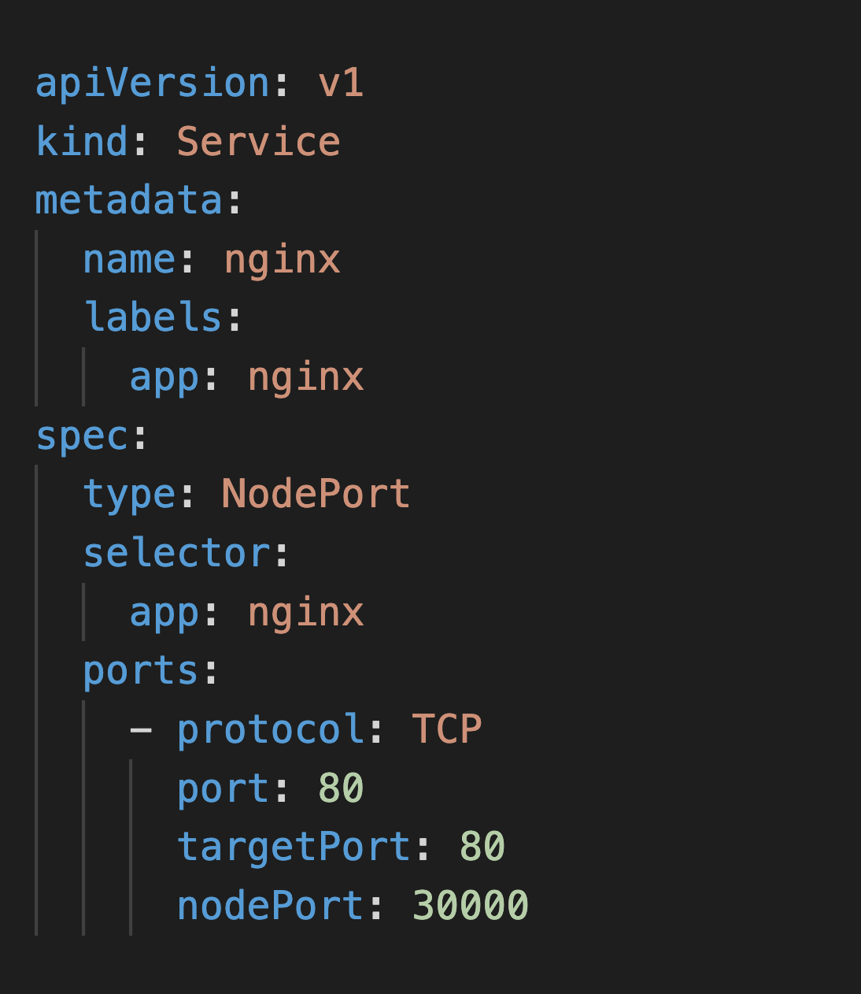
SERVICE

Slide 28
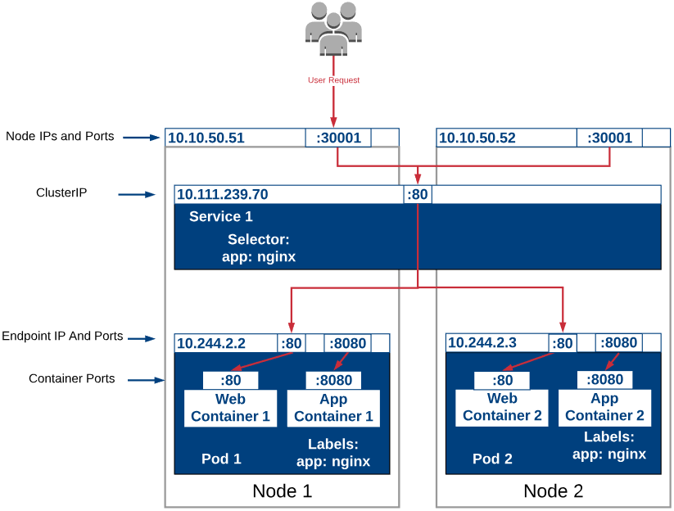
SERVICE

Slide 29
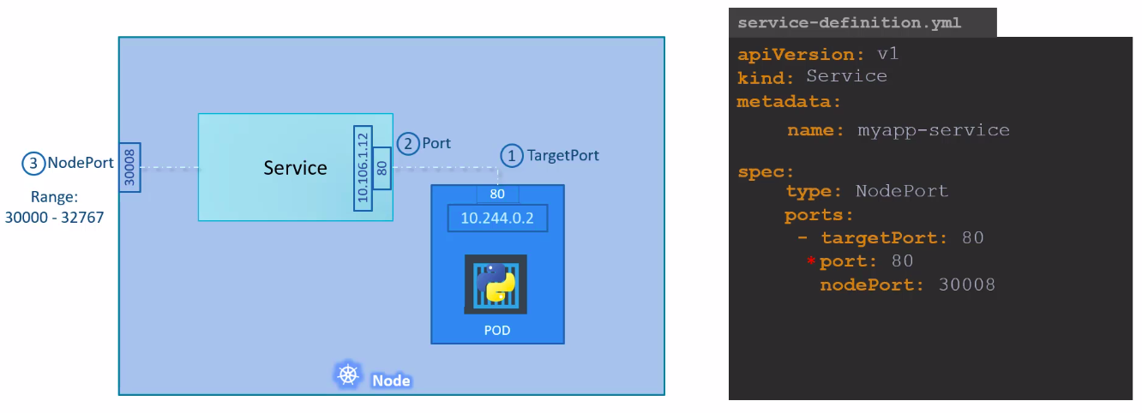
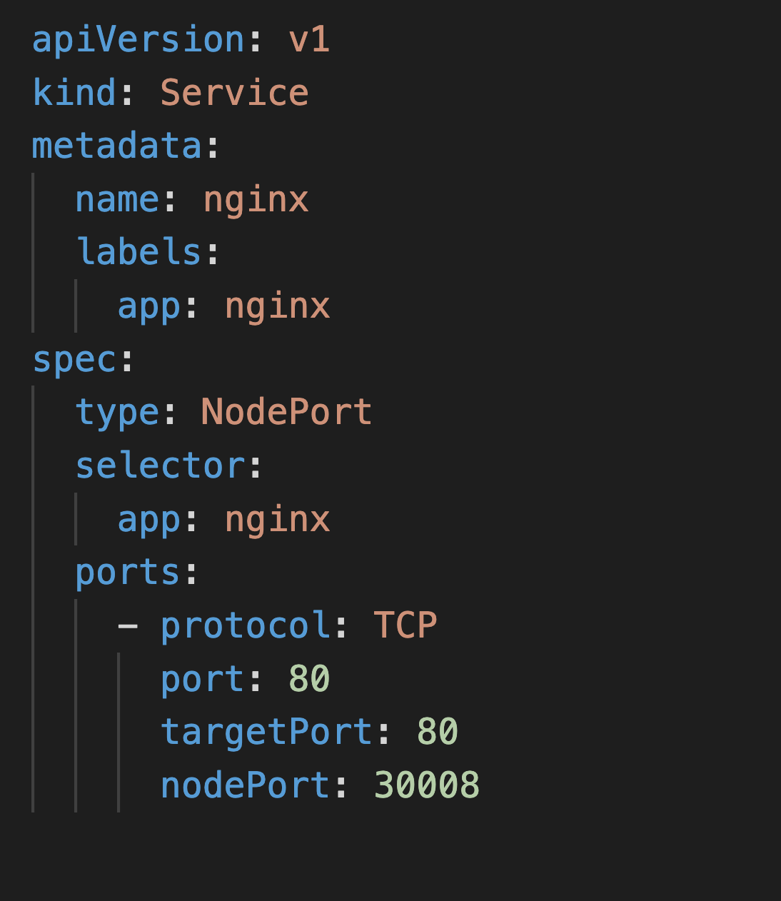
SERVICE NodePort

Slide 30
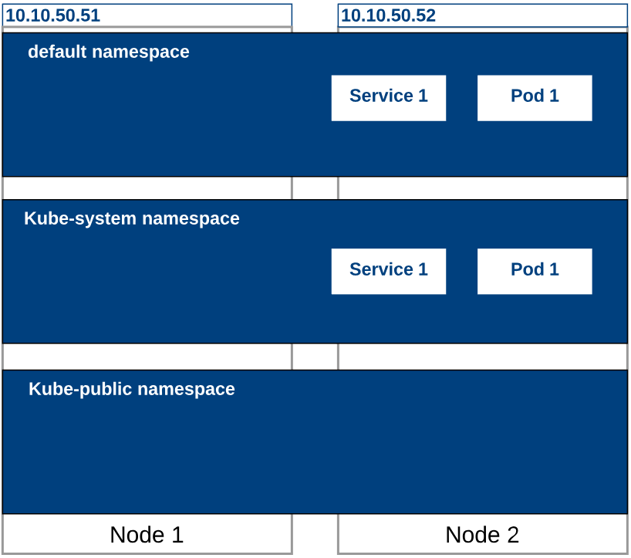
NAMESPACE

Slide 31
NAMESPACE
Kubernetes supports multiple virtual clusters in the same physical cluster.
These virtual clusters are called namespaces.
Names of the resources need to be unique within a namespace but not across the namespaces.
The namespaces cannot be nested inside one another, and each namespace can have only one Kubernetes resource.
Namespaces are a method to divide the cluster resources between multiple users.

Slide 32
YAML FILE FOR NAMESPACE
apiVersion: v1
kind: Namespace
metadata:
name: dev-ns

Slide 33
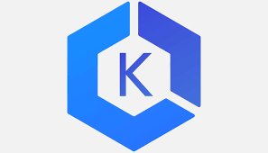
Amazon Elastic Kubernetes Service
Orchestration Using Kubernetes

Slide 34
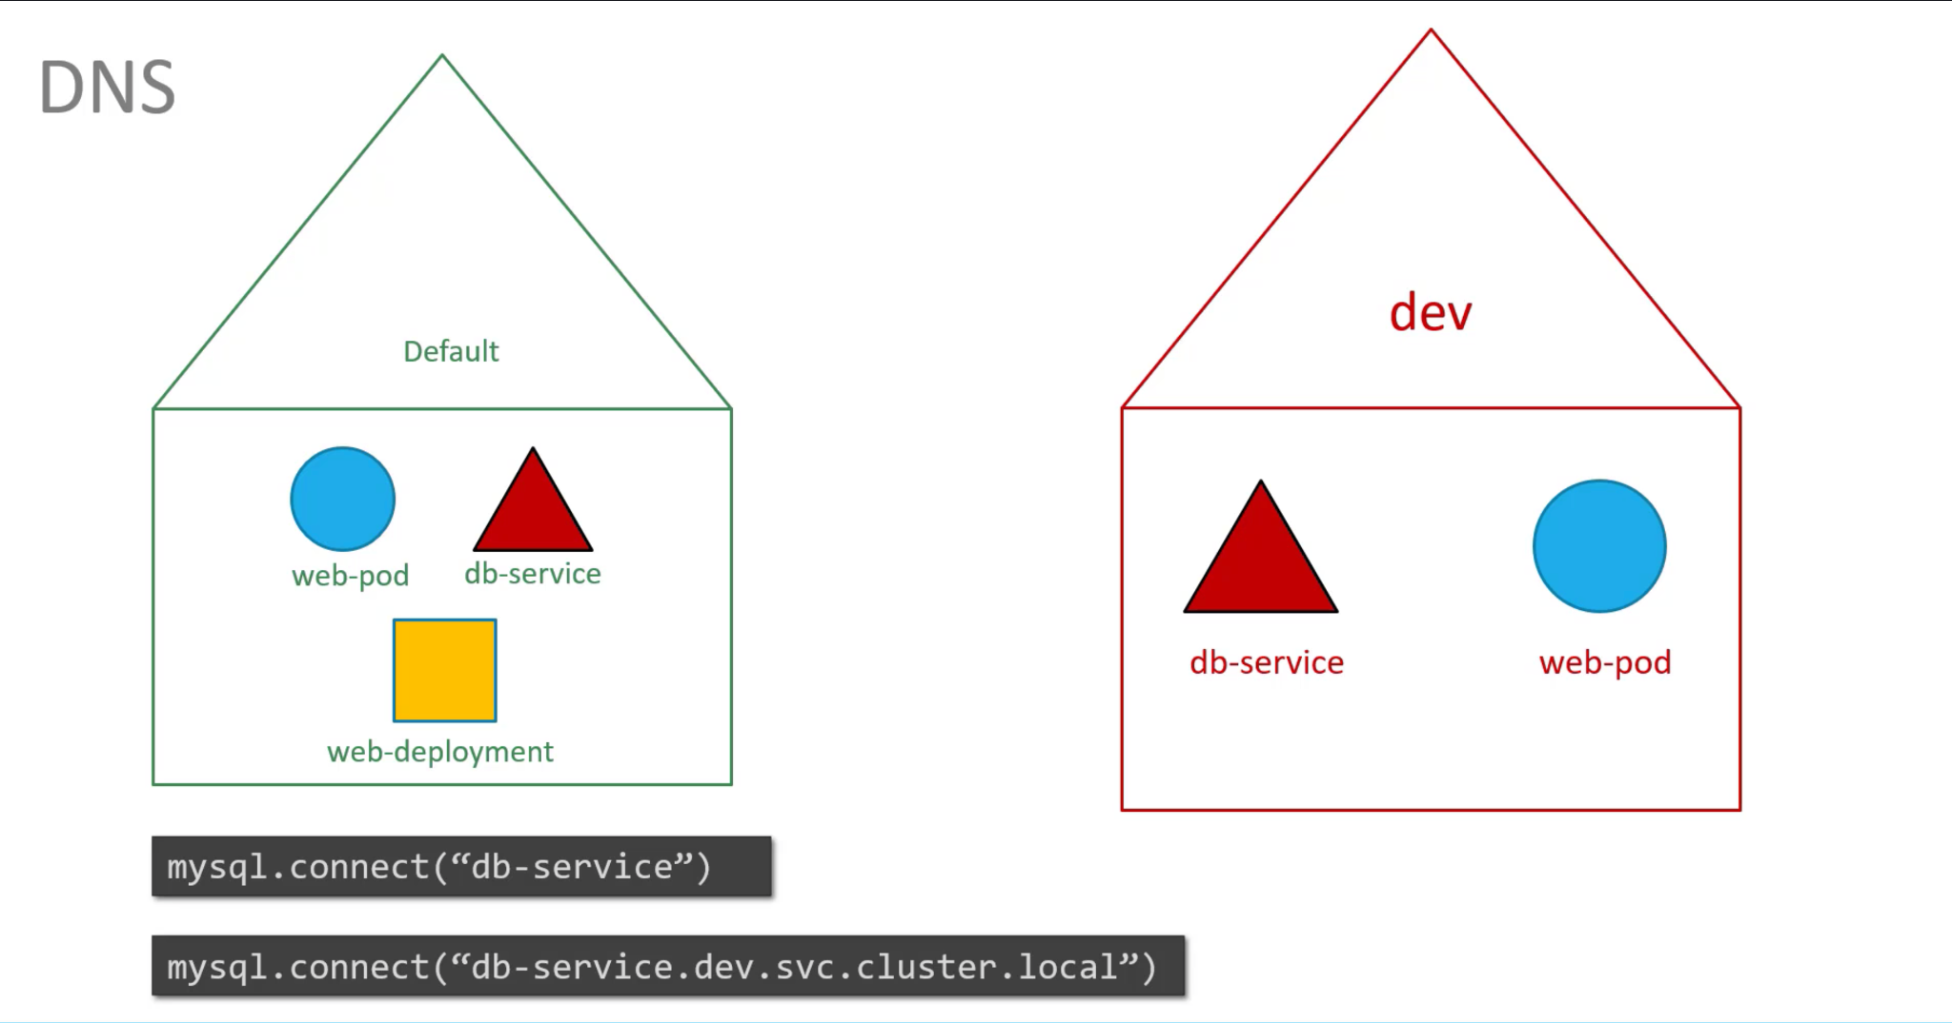
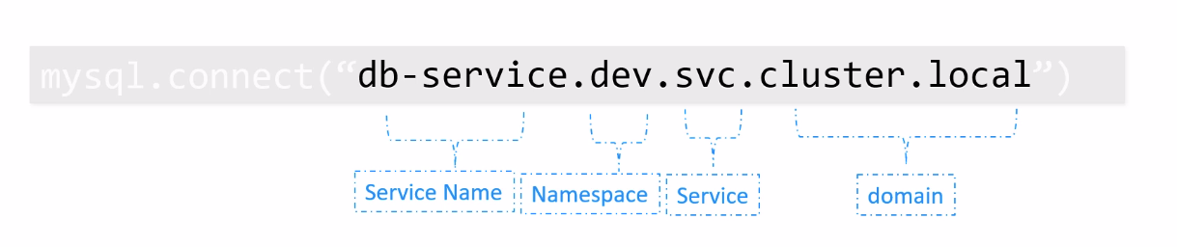
How to call services from one namespace to service present in another namespace?

Slide 35
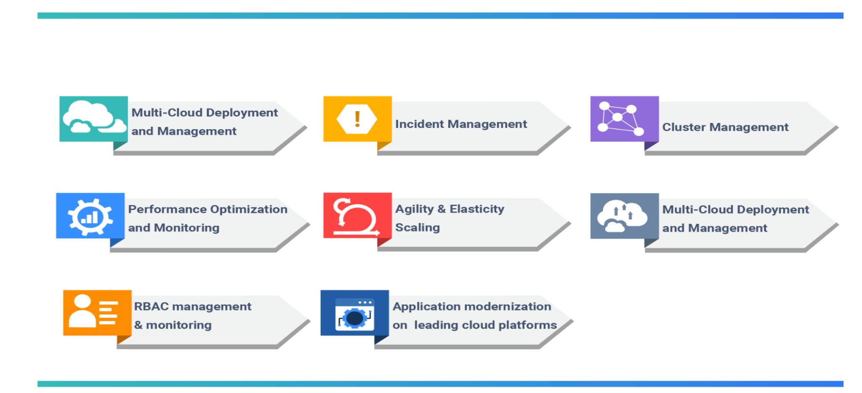
Why Managed Service?

Slide 36
Managed Kubernetes Service
Managed Kubernetes is when third-party providers take over responsibility for some or all of the work necessary for the successful setup and operation of Kubernetes.
Manages all of the maintenance and configuration needed for your infrastructure
Has built-in authentication and access controls for centralised management
Also takes care of the monitoring and logging of the cluster
Examples: Amazon Elastic Kubernetes Service (EKS), Google Kubernetes Engine or Azure Kubernetes Service

Slide 37
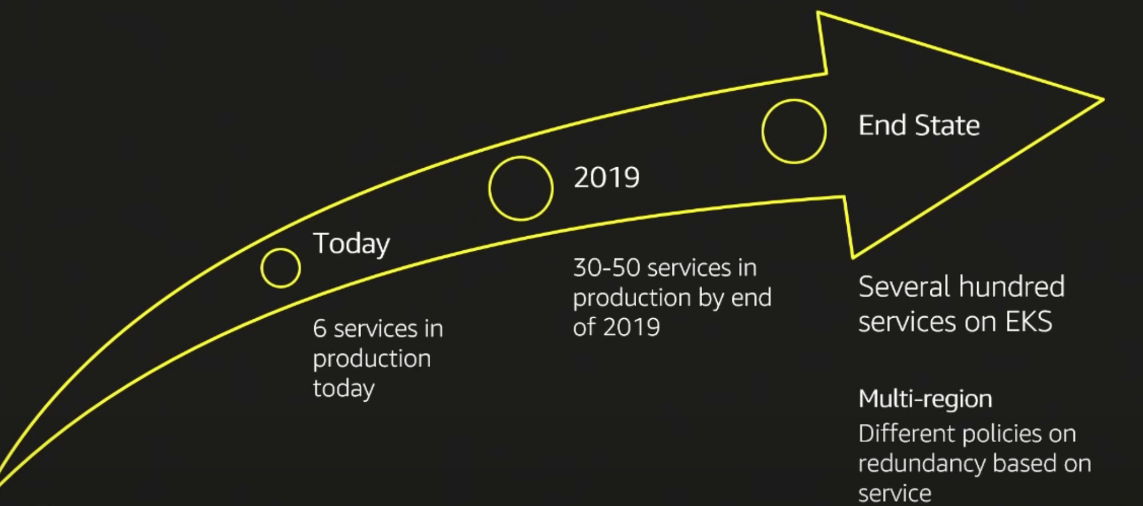

EKS Introduction

Slide 38
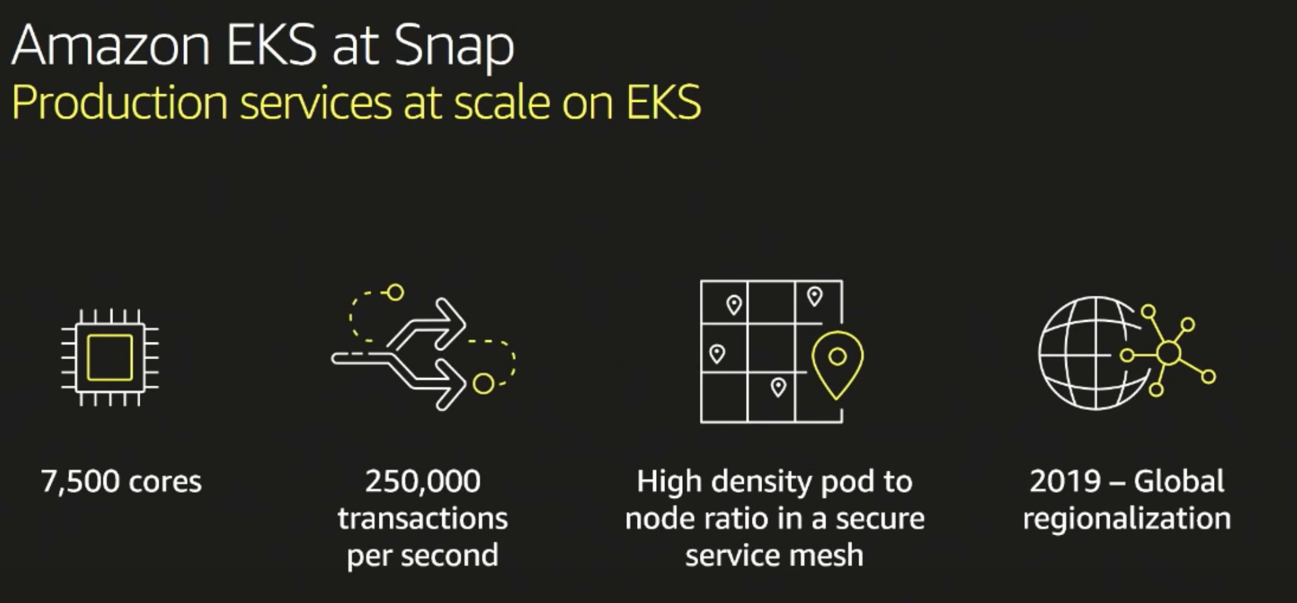
EKS Introduction

Slide 39
EKS Introduction
With AWS EKS, the Kubernetes control plane components provides a high availability and eliminates a single point of failure by provisioning and scaling the components across various AWS availability zones.
It is well integrated with various other AWS services like EC2 auto scaling, IAM, Load Balancers, making it easy for organisations to scale and secure applications seamlessly.

Slide 40
Benefits of Using AWS EKS
Improves availability and observability
  EKS offers a 99.95% uptime SLA
Provisions and scales your resources efficiently
  With EKS-managed node groups, you need not provision compute capacity separately to scale your Kubernetes applications
  You can also choose AWS Fargate to automatically provision on-demand serverless compute for your applications
Gets a more secure Kubernetes environment
  EKS automatically applies the latest security patches to your cluster’s control plane

Slide 41
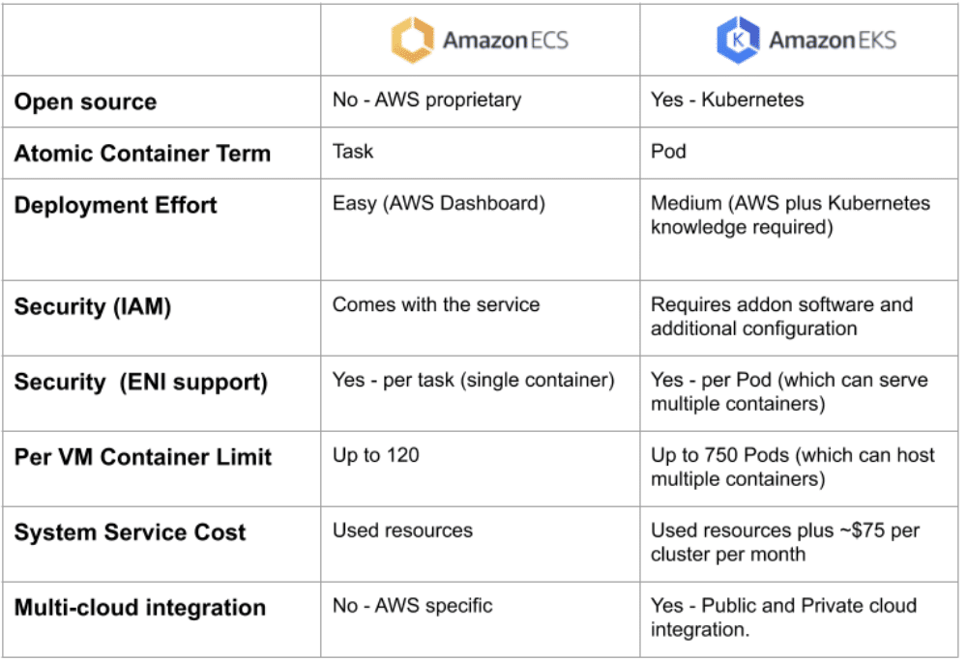
ECS vs EKS

Slide 42
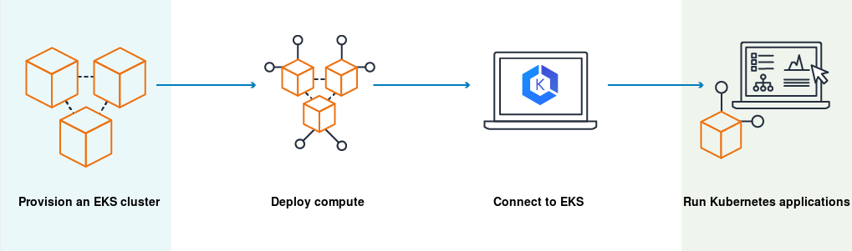
How does Amazon EKS work?

Slide 43
Pricing
An Amazon EKS cluster consists of a control plane and the Amazon EC2 or AWS Fargate compute that you run pods on
It costs $0.10 per hour for each Amazon EKS cluster created
If EC2 instances (including EKS-managed node groups) are being used, the usage of the AWS resources (for example, EC2 instances or EBS volumes) created to run the Kubernetes worker nodes will also be billed.
If AWS Fargate is being used, pricing is calculated based on the vCPU and memory resources used

Slide 44
Cluster setup
To create a new Kubernetes cluster with nodes in Amazon EKS, use the following:
eksctl - A simple command line utility for creating and managing Kubernetes clusters on Amazon EKS
AWS management console and AWS CLI - To launch Amazon EKS using the AWS management console and AWS CLI. The procedures give you visibility into how each resource is created and how these resources interact with each other

Slide 45
eksctl
eksctl is a simple CLI tool for creating and managing clusters on EKS
It is written in Go, uses CloudFormation and was created by Weaveworks
Create a basic cluster in minutes with just one command:
  eksctl create cluster
  Note that a cluster will be created with default parameters
Reference: https://eksctl.io/

Slide 46
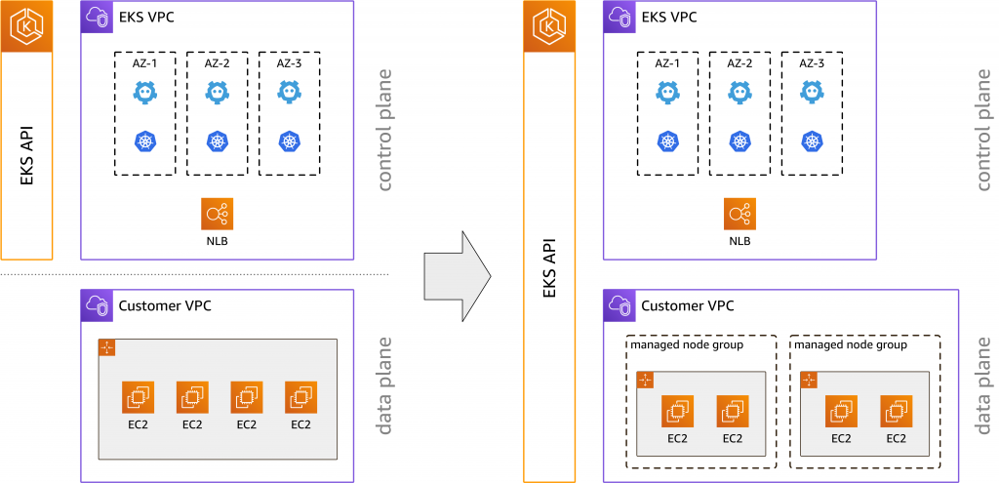
Node Groups

Slide 47
Self-managed nodes
EKS clusters have two infrastructure components, no matter what option you pick (even serverless):
  EKS Control Plane (also known as the ‘EKS Cluster’ in the AWS Console)
  Worker nodes
Self-managed nodes - Manually provision EC2 instances or autoscaling groups and register them as worker nodes to EKS
Self-managed nodes gives you full access to configure the workers to meet almost any infrastructure need

Slide 48
Managed node groups
Amazon EKS-managed node groups create and manage Amazon EC2 instances on your behalf.
All managed nodes are provisioned as a part of an Amazon EC2 autoscaling group that is managed for you by Amazon EKS

Slide 49
Managed node groups
A managed node group's autoscaling group spans all of the subnets that you specify when you create the group
A managed node group gracefully drains nodes before termination during a scale down event
By default, instances in a managed node group use the latest version of the Amazon EKS-optimised Amazon Linux 2 AMI for their cluster's Kubernetes version
Managed node group capacity types are as follows:
  On-demand
  Spot

Slide 50
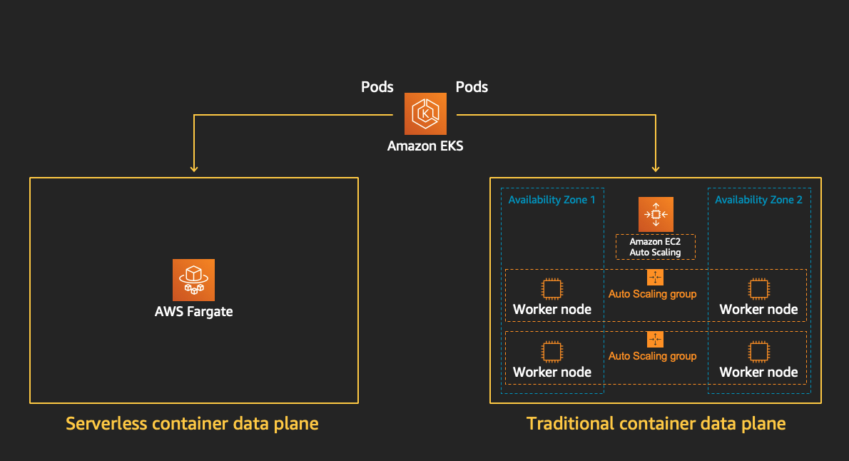
Fargate

Slide 51
Fargate
AWS Fargate provides on-demand, right-sized compute capacity for containers
There is no need to provision, configure or scale groups of virtual machines to run containers
Daemonsets are not supported on Fargate
At least one Fargate profile specifying which pods should use Fargate must be defined when they are launched
Pods that do not match a Fargate profile may be stuck as ‘Pending’

Slide 52
Cluster authentication
The IAM entity user or role, that creates the cluster, is automatically granted system:masters permissions in the cluster's RBAC configuration in the control plane
To grant additional AWS users or roles the ability to interact with the cluster, the aws-auth ConfigMap should be edited within Kubernetes
We can add IAM users, roles or AWS accounts to configMap. But, we cannot add IAM groups to configMap
    aws sts get-caller-identity
    kubectl describe configmap -n kube-system aws-auth
    kubectl edit -n kube-system configmap/aws-auth

Slide 53
Using spot and on-demand nodes
Running your Kubernetes and containerised workloads on Amazon EC2 Spot Instances is an excellent way to save costs
You can run your EKS nodes on either fully on-demand servers or spot servers or a combination of both after specifying the percentage of both the server types
It is recommended to specify multiple server types in case you are using spot instance EKS nodes as specified in the diagram in the last slide
We can do this by opening the purchase options and instance types options in the autoscaling group of our EKS nodes, and there, we can select the server types or category
Explore more

Slide 54
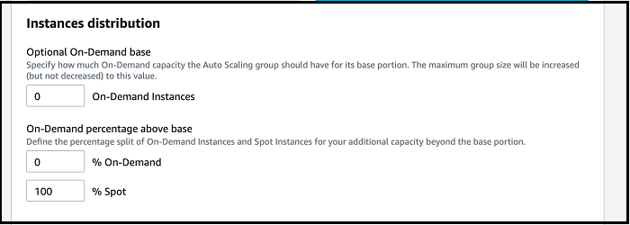
Using spot and on-demand nodes

Slide 55
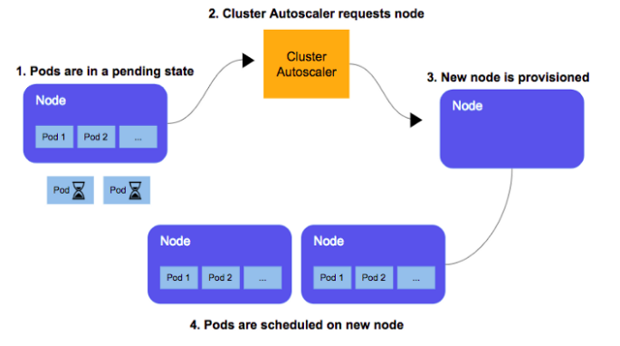
Autoscaling of nodes
When you create an EKS cluster and deploy a node group by console, it will create an autoscaling group by default with a default EKS launch template
You can manage nodes of an EKS cluster by Cluster Autoscaler
The Kubernetes Cluster Autoscaler automatically adjusts the number of nodes in your cluster when pods fail or are rescheduled onto other nodes

Slide 56
Autoscaling of nodes
Deploying Cluster Autoscaler
  kubectl apply -f https://raw.githubusercontent.com/kubernetes/autoscaler/master/cluster-autoscaler/cloudprovider/aws/examples/cluster-autoscaler-autodiscover.yaml
The command provided above will create the following:
  ServiceAccount
  Clusterrole
  ClusterRoleBinding
  Deployment
Cluster Autoscaler is typically installed as a deployment in the cluster. It uses leader election to ensure high availability, but a single replica is scaled at a time.

Slide 57
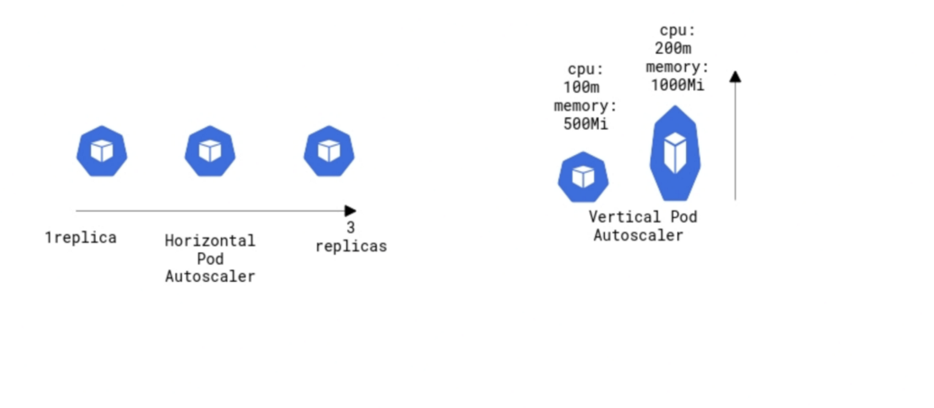
Autoscaling of pods

Slide 58
Autoscaling of pods
Horizontal pod autoscaling (HPA)
  The Horizontal Pod Autoscaler automatically scales the number of pods in a replication controller, deployment, replica set or stateful set based on the metrics specified
Vertical pod autoscaling (VPA)
  The Kubernetes Vertical Pod Autoscaler automatically adjusts the CPU and memory reservations for your pods to help ‘right-size’ the applications.
  This adjustment can improve cluster resource utilisation and free up CPU and memory for other pods
  Explore more using the following link:
https://docs.aws.amazon.com/eks/latest/userguide/vertical-pod-autoscaler.html

Slide 59
Metric Server
To make the HPA work, we first need to have the metrics server pod running in our EKS cluster
The metrics server is a cluster-wide aggregator of resource usage data.
It collects metrics such as CPU or memory consumption for containers or nodes from the Summary API exposed by Kubelet on each node

Slide 60
Metric Server Installation
Following are the steps for installing metrics server:
  kubectl apply -f https://github.com/kubernetes-sigs/metrics-server/releases/download/v0.3.6/components.yaml
  This command will deploy the metrics server pod.
  kubectl get pods -n kube-system -l k8s-app=metrics-server to check whether the metrics server pod is running or not
  We need the metrics server for HPA or VPA because, by the metrics server, only Kubelet will know the pod’s resource utilisation, and according to that, HPA will work

Slide 61
IAM roles
The IAM users and roles do not have the permissions to create or modify Amazon EKS resources by default. An IAM administrator must create IAM policies that grant users and roles permission to perform specific API operations on the specified resources they need
The roles can be granted to nodes by attaching the role in the launch template of the EKS autoscaling group
In the Amazon EKS node, Kubelet daemon makes calls to AWS APIs on your behalf. Nodes receive permissions for these API calls through an IAM instance profile and associated policies. Before you can launch nodes and register them into a cluster, you must create an IAM role for those nodes to use when they are launched

Slide 62
Doubt Clearance Window

Slide 63
Tasks to Complete After Today’s Session
MCQs
Conceptual Questions
Project Checkpoint

Slide 64
Thank You!

